Slide 1







React Architecture
How To Use Flux
React.js Development
SoftUni Team
Technical Trainers
Software University
http://softuni.bg

Slide 2

Table of Contents
Flux Architecture
Actions
Stores
Dispatcher
Views
Thinking In React
Best Practices

Slide 3
Have a Question?
sli.do #react-js

Slide 4
Flux Architecture
How To Separate Our App

Slide 5
Flux Architecture
React is very powerful library for building SPA apps
It uses uni-directional data flow
Communication between components happens in two ways
By passing props – from parent to child
By passing event handlers – from child to parent
However, if the app becomes big and a lot of nested components emerge, it gets tricky to keep track of everything
In order to fix this we will use Flux

Slide 6
Flux Architecture
How Flux helps us
It changes how data enters our application
It changes how components gets or sets data
Flux comes from Facebook and it's not a framework
It is rather a solution to a common problem
It makes our data flows in single direction
It helps adding new functionality without making complex apps

Slide 7
Flux Architecture
In Flux we separate our application in the following way
Actions
Dispatcher
Stores
Views
Each of them has a single purpose

Slide 8
Flux Architecture
Actions
Objects we create when some of the state changes
Each action has type property showing what type of action it is
And any other properties allowing the state to change
let action = {
type: "CREATE_TODO",
title: "Go shopping"
}

Slide 9
Flux Architecture
Stores
Actions are dispatched to stores
They are responsible for managing the application's data
They provide methods for accessing the data but not for changing it
If you want to change the data, you need to create an action and dispatch it to the store

Slide 10
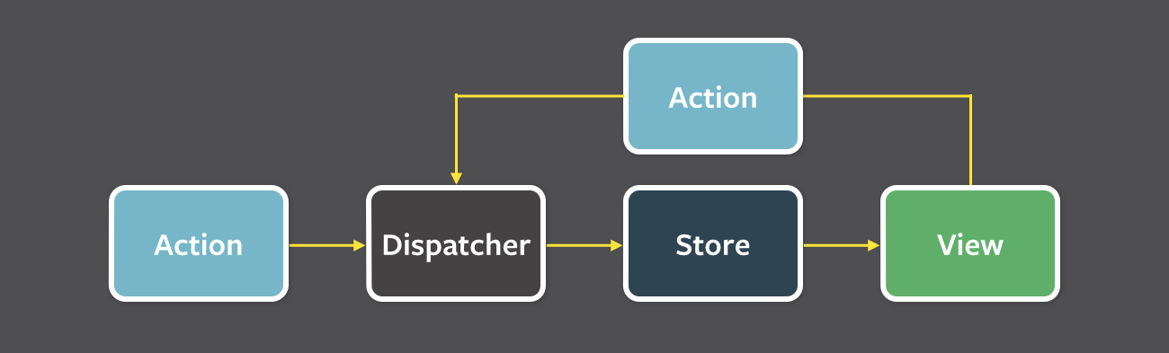
Flux Architecture
Dispatcher
It is responsible for dispatching all actions to all stores
You can't dispatch an action without going through the dispatcher

Slide 11
Flux Architecture
We will be making a To Do app
First install Flux
Let's first create a dispatcher – create dispatcher.js file
npm install flux –-save
import { Dispatcher } from 'flux'
export default new Dispatcher()

Slide 12
Flux Architecture
Then we need an action for creating a new To Do
Create folder actions and a file TodoActions.js
import dispatcher from '../dispatcher'
let todoActions = {
createTodo: (title) => {
dispatcher.dispatch({
type: 'CREATE_TODO',
title
})
}
}
export default todoActions

Slide 13
Flux Architecture
Then we need a store for handling our data
Create folder stores and a file TodoStore.js
import { EventEmitter } from 'events'
import dispatcher from '../dispatcher'
class TodoStore extends EventEmitter {
constructor () {
super()
this.todos = [
{ id: 1, title: 'Go shopping', completed: false },
{ id: 2, title: 'Go walking', completed: false }
]
}
// continues on the next slide

Slide 14
Flux Architecture
// continues from the previous slide
createTodo (title) {
const id = this.todos.length + 1
this.todos.push({
id,
title,
completed: false
})
this.emit('change')
}
getAll () {
return this.todos.slice(0)
}
// continues on the next slide

Slide 15
Flux Architecture
// continues from the previous slide
handleAction (action) {
switch (action.type) {
case 'CREATE_TODO': {
this.createTodo(action.title)
}
}
}
}
let todoStore = new TodoStore()
dispatcher.register(todoStore.handleAction.bind(todoStore))
export default todoStore

Slide 16
Flux Architecture
Let's create our React components
Create folder components and a file Todo.js
import React from 'react'
const Todo = (props) => (
<li>
{props.title} - {props.completed ? 'DONE' : 'PENDING'}
</li>
)
export default Todo

Slide 17
Flux Architecture
Add file Todos.js
import React, { Component } from 'react'
import Todo from './Todo'
import TodoStore from '../stores/TodoStore'
import TodoActions from '../actions/TodoActions'
class Todos extends Component {
constructor (props) {
super(props)
this.state = {
title: '',
todos: []
}
TodoStore.on('change', () => {
this.getAllTodos()
})
}
// continues on the next slide

Slide 18
Flux Architecture
// continues from the previous slide
componentDidMount () {
this.getAllTodos()
}
getAllTodos () {
TodoStore
.getAll()
.then(todos => this.setState({ todos }))
}
createTodo (event) {
event.preventDefault()
TodoActions.createTodo(this.state.title)
this.setState({ title: '' })
}
// continues on the next slide

Slide 19
Flux Architecture
// continues from the previous slide
handleChange (event) {
this.setState({ title: event.target.value })
}
render () {
const { todos } = this.state
const todoElements = todos.map(todo => (
<Todo key={todo.id} {...todo} />
))
// continues on the next slide

Slide 20
Flux Architecture
// continues from the previous slide
return (
<div>
<ul>{todoElements}</ul>
<div>
<input
type='text'
ref='title'
value={this.state.title}
onChange={this.handleChange.bind(this)} />
<button onClick={this.createTodo.bind(this)}>Add</button>
</div>
</div>
)
}
}
export default Todos

Slide 21
Flux Architecture
Finally update App.js
import React, { Component } from 'react'
import Todos from './components/Todos'
import './App.css'
class App extends Component {
render () {
return (
<div className='App'>
<h1>My Todo List</h1>
<hr />
<Todos />
</div>
)
}
}
export default App

Slide 22
Thinking In React
How To Build Our App

Slide 23
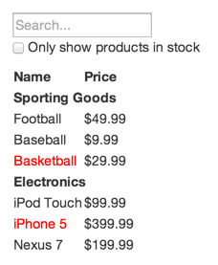
Thinking In React
When you use React, you should be able to separate your app into small single-purpose components
Let's imagine we have the following design

Slide 24
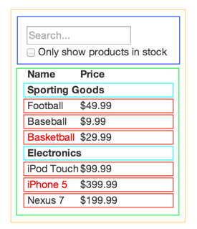
Thinking In React
First - you need to break the app into component hierarchy
FilterableProductTable (orange)
SearchBar (blue)
ProductTable (green)
ProductCategoryRow (turquoise)
ProductRow (red)

Slide 25
Thinking In React
Second - you need to build a static version of the site – no state or props or any data flow, just the HTML
Third – identify the application state and it's flow
Fourth – implement it using an architecture of your choice
That's it!

Slide 26
Best Practices
How To Build Our App

Slide 27
Best Practices
Read this: https://engineering.musefind.com/our-best-practices-for-writing-react-components-dec3eb5c3fc8?gi=aae1f3854926
Always use linters – standard is a good one
Use JSX. It helps!
Use classes for components (or a simple function, if it's a simple component)
Use PropTypes wherever possible. It can save you a lot of work!
Separate your components into containers and presentation ones

Slide 28
Best Practices
Presentational
Concerned with how things look
Have no dependencies on the rest of the app, such as Flux actions or stores
Don’t specify how the data is loaded or mutated
Receive data and callbacks exclusively via props
Rarely have their own state (when they do, it’s UI state rather than data)

Slide 29
Best Practices
Containers
Are concerned with how things work
Provide the data and behavior to presentational or other container components
Call Flux actions and provide these as callbacks to the presentational components
Are often stateful, as they tend to serve as data sources

Slide 30








JavaScript Web – React.js Fundamentals
https://softuni.bg/trainings/1434/node-js-development-september-2016

Slide 31

License
This course (slides, examples, demos, videos, homework, etc.) is licensed under the "Creative Commons Attribution-NonCommercial-ShareAlike 4.0 International" license
Attribution: this work may contain portions from
"End-to-end JavaScript Applications" course by Telerik Academy under CC-BY-NC-SA license

Slide 32





Free Trainings @ Software University
Software University Foundation – softuni.org
Software University – High-Quality Education, Profession and Job for Software Developers
softuni.bg
Software University @ Facebook
facebook.com/SoftwareUniversity
Software University @ YouTube
youtube.com/SoftwareUniversity
Software University Forums – forum.softuni.bg

